Slide 1

Scikit-learn in python
Package That Provides Efficient Versions Of A Large Number Of Common Algorithms

Slide 2
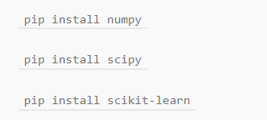
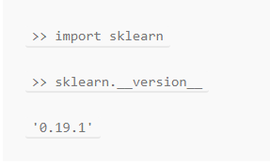
Installation:
Import:

Slide 3
If you’re going to do Machine Learning in Python, Scikit-Learn is the gold standard. Scikit-learn provides a wide selection of supervised and unsupervised learning algorithms. Best of all, it’s by far the easiest and cleanest ML library.

Slide 4
Scikit-Learn is built on top of several common data and math Python libraries. Such a design makes it super easy to integrate between them all. You can pass numpy arrays and pandas data frames directly to the ML algorithms of Scikit! It uses the following libraries:
NumPy: For any work with matrices, especially math operations
SciPy: Scientific and technical computing
Matplotlib: Data visualization
IPython: Interactive console for Python
Sympy: Symbolic mathematics
Pandas: Data handling, manipulation, and analysis

Slide 5
Scikit-Learn is focused on Machine Learning, e.g data modelling.
It is not concerned with the loading, handling, manipulating, and visualizing of data.
Scikit’s robust set of algorithm offerings includes:
Regression: Fitting linear and non-linear models
Clustering: Unsupervised classification
Decision Trees: Tree induction and pruning for both classification and regression tasks
Neural Networks: End-to-end training for both classification and regression. Layers can be easily defined in a tuple
SVMs: for learning decision boundaries
Naive Bayes: Direct probabilistic modelling
Even beyond that, it has some very convenient and advanced functions not commonly offered by other libraries:
Ensemble Methods: Boosting, Bagging, Random Forest, Model voting and averaging
Feature Manipulation: Dimensionality reduction, feature selection, feature analysis
Outlier Detection: For detecting outliers and rejecting noise
Model selection and validation: Cross-validation, Hyperparameters tuning, and metrics

Slide 6
Data Representation in Scikit-Learn:
Machine learning is about creating models from data: for that reason, The best way to think about data within Scikit-Learn is in terms of tables of data.
Data exploration is a very important step in any Data Science or Machine Learning project. Even a quick exploration of the data set can give us important information that we might otherwise miss, and that information can suggest important questions we can try to answer through our project.
Data as table
A basic table is a two-dimensional grid of data, in which the rows represent individual elements of the dataset, and the columns represent quantities related to each of these elements.
we can start with the head() and tail() methods provided from PANDAS library and exploring the daya type of our data like this ourdataframe.dtypes

Slide 7
Preprocessing Data
the algorithms in scikit-learn understand only numeric data .
Luckily, the scikit-learn library provides us with many methods for converting string data into numerical data. One such method is the LabelEncoder() method. We will use this method to convert the categorical labels in our data set into numerical labels.

Slide 8
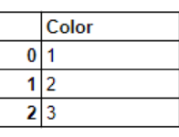
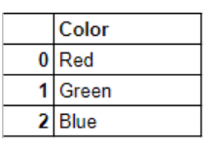
The image below represents a dataframe that has one column named ‘color’ and three records ‘Red’, ‘Green’ and ‘Blue’.
Since the machine learning algorithms in scikit-learn understand only numeric inputs, we would like to convert the categorical labels like ‘Red, ‘Green’ and ‘Blue’ into numeric labels. When we are done converting the categorical labels in the original dataframe, we would get something like this:

Slide 9
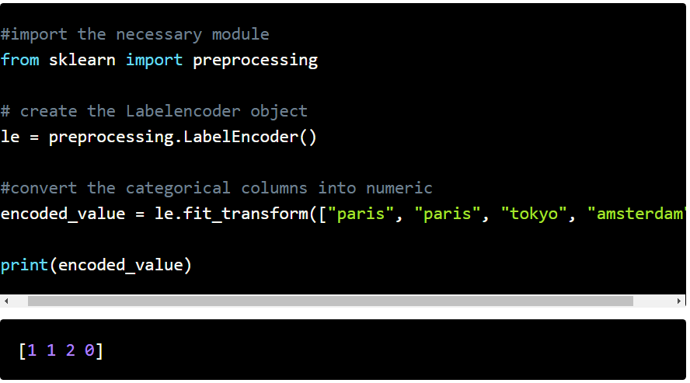
encoded data :
We will use the fit_transform() method provided by LabelEncoder() to encode the labels in the categorical column in dataframe and convert them into numeric labels similar to what we visualized in the previous diagrams.
The fit_transform() function takes user defined labels as input and then returns encoded labels.

Slide 10
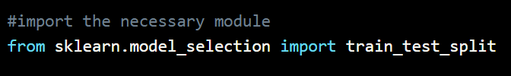
Training Set & Test Set
A Machine Learning algorithm needs to be trained on a set of data to learn the relationships between different features and how these features affect the target variable. For this we need to divide the entire data set into two sets. One is the training set on which we are going to train our algorithm to build a model. The other is the testing set on which we will test our model to see how accurate its predictions are.
we used the train_test_split() method to divide the data into a training set (data_train,target_train) and a test set (data_test,data_train).

Slide 11
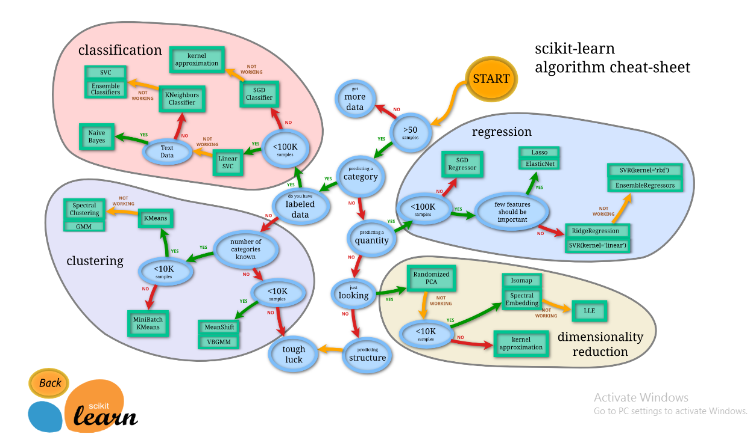
Building The Model
There’s a machine_learning_map available on scikit learn’s website that we can use as a quick reference when choosing an algorithm.

Slide 12
Steps of training
we train any algorithm on the testing data(data_train) and testing target(target_train) using the fit()method, and then predicted the targets in the test data using the predict()method. Finally we printed the score using the accuracy_score() method .

Slide 13
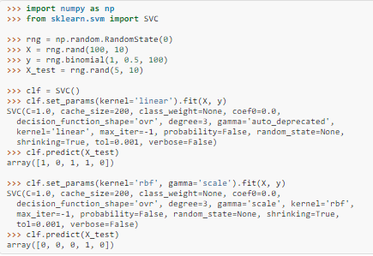
Refitting and updating parameters
Hyper-parameters of an estimator can be updated after it has been constructed via the set_params() method. Calling fit() more than once will overwrite what was learned by any previous fit():
Here, the default kernel rbf is first changed to linear via SVC.set_params() after the estimator has been constructed, and changed back to rbf to refit the estimator and to make a second prediction

Slide 14
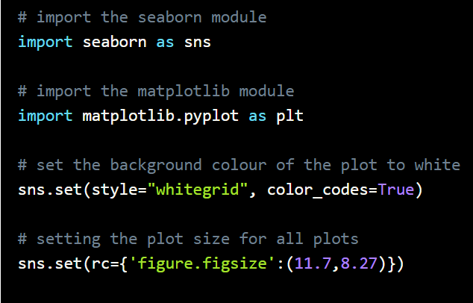
Data Visualization
There are many python libraries that provide functions for doing data visualization; such Seaborn , matplotlib .

Slide 15
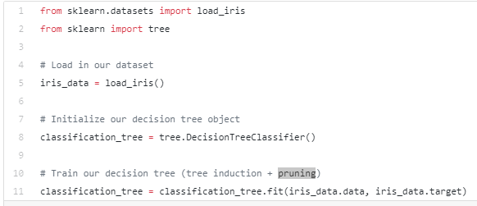
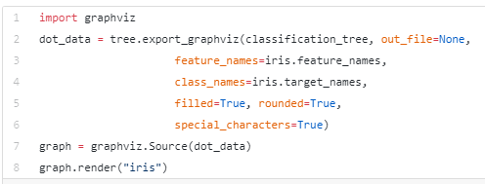
In case of Decision Trees algorithm
Scikit Learn also allows us to visualise
our tree using the graphviz library.

Slide 16
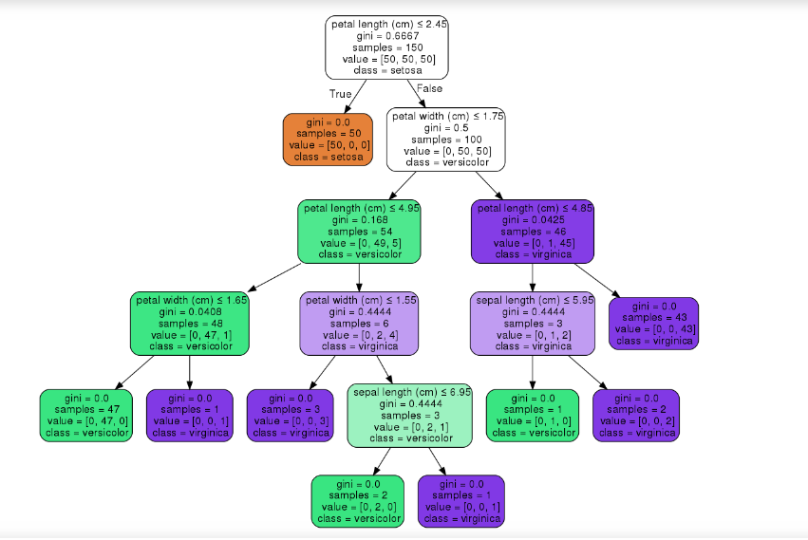

Slide 17

Thank You

